Slide 1
Newton’s Method for Optimization
Caleb Maddry

Slide 2
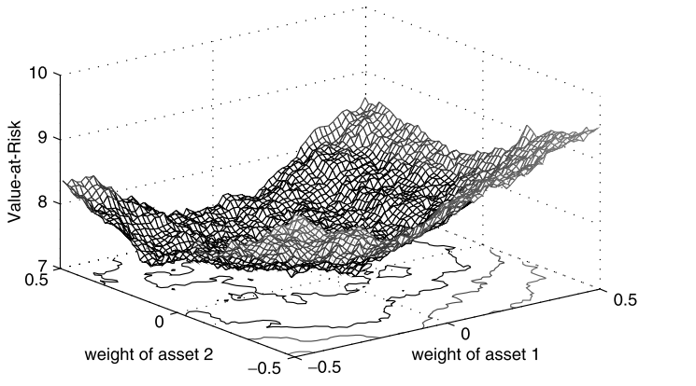
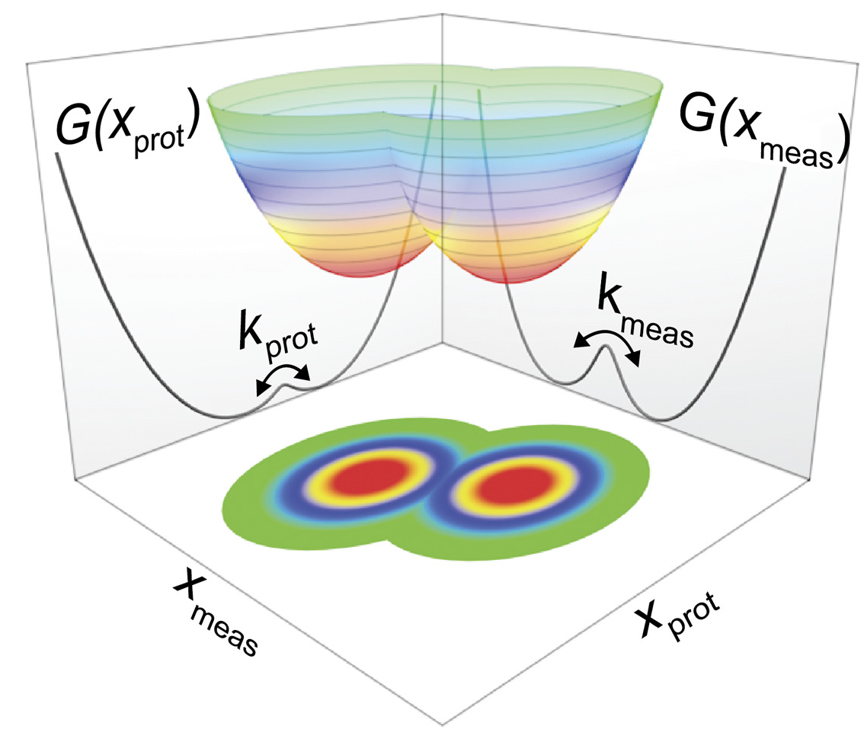
What is optimization?
Minimization of a function given a set of inputs
Applications of numerical optimization
Science/Engineering
Molecular modeling
Control systems
Finance
Portfolio optimization
Econometric models
Policy
Resource allocation
Risk models
Applications of optimization are everywhere
Gilli et al. (2019)
Edwards et al. (2020)

Slide 3
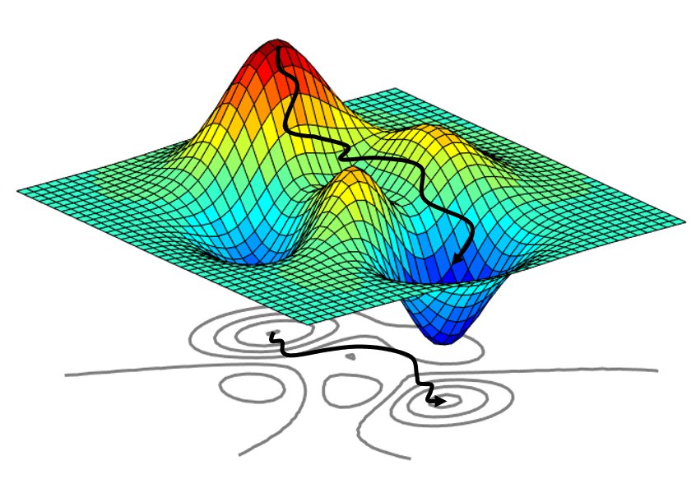
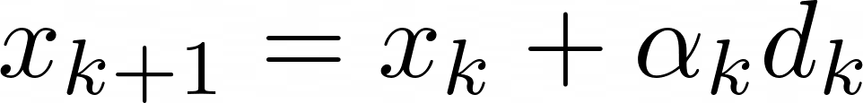


Line-search methods
Iterative method:
1. Step direction,
Determines which direction to take the step
2. Step length,
Determines how large the step should be

Slide 4
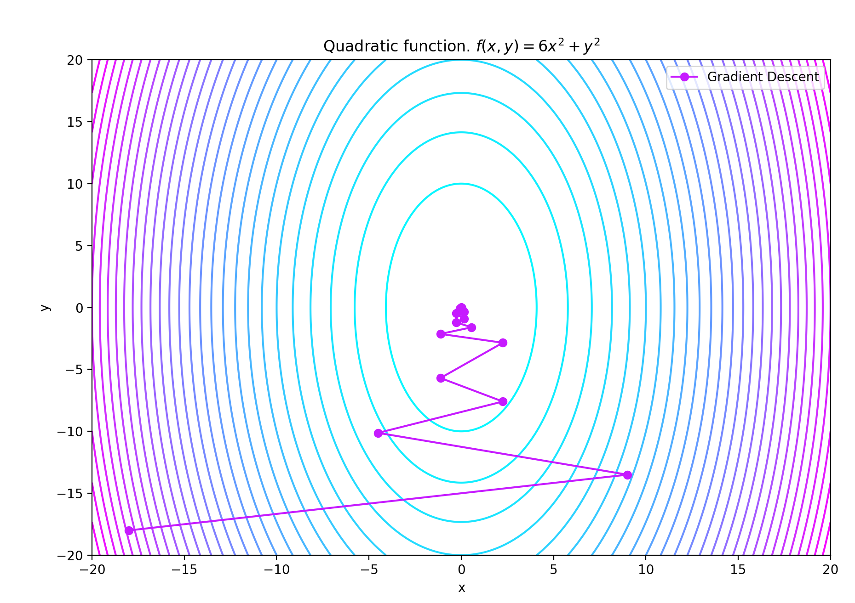

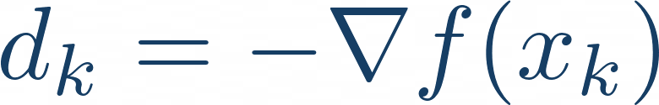
Steepest descent and the descent direction
Descent direction:
Steepest descent is a basic optimization method
Uses the gradient as the descent direction:
RELIABLE WHEN
Converges linearly
Step length is chosen with a backtracking line search

Slide 5
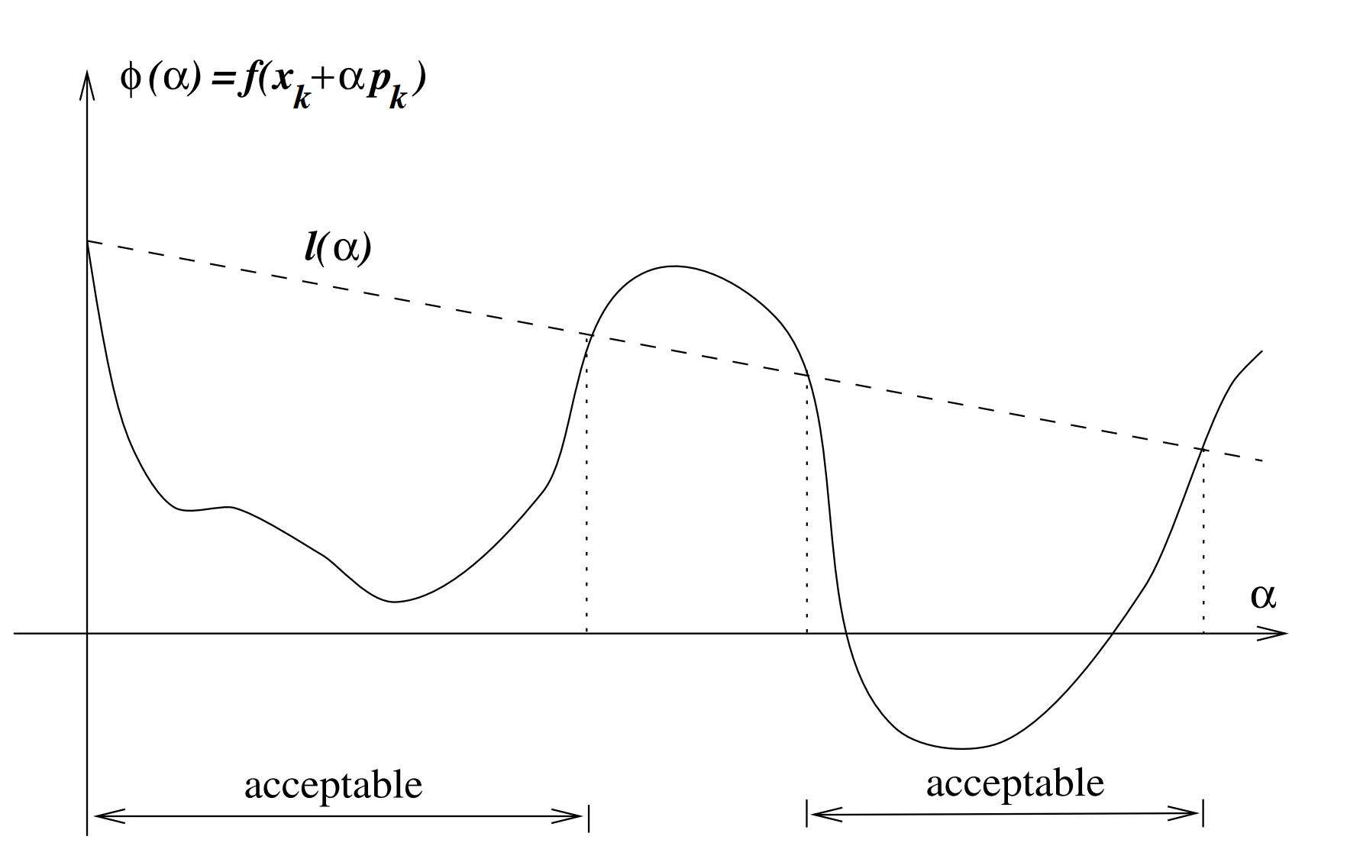
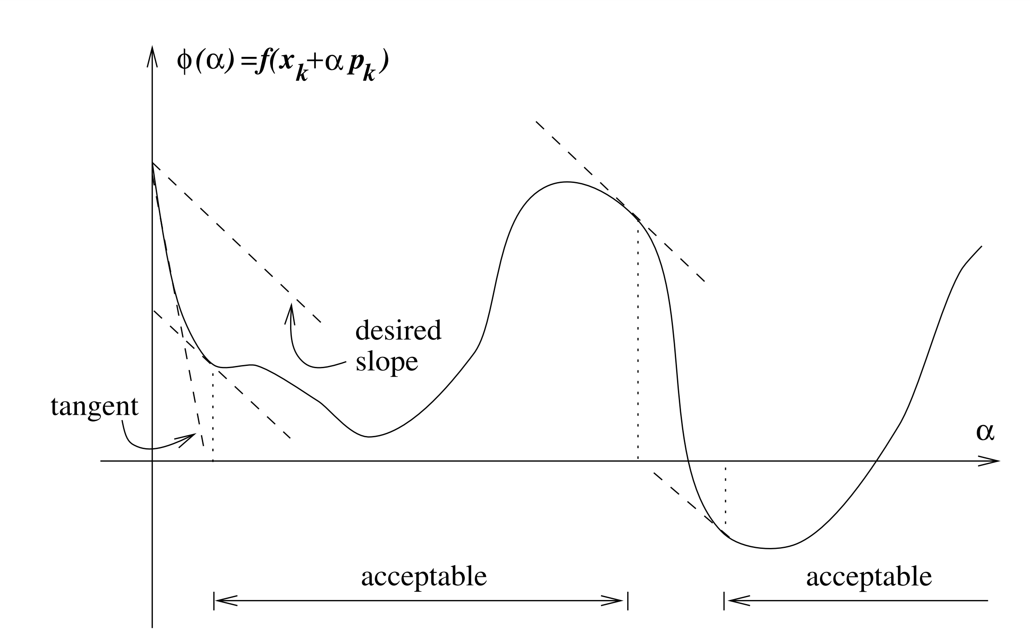
Backtracking line search to find
Find an inexact solution to:
Sufficient decrease condition
Curvature condition
Nocedal

Slide 6
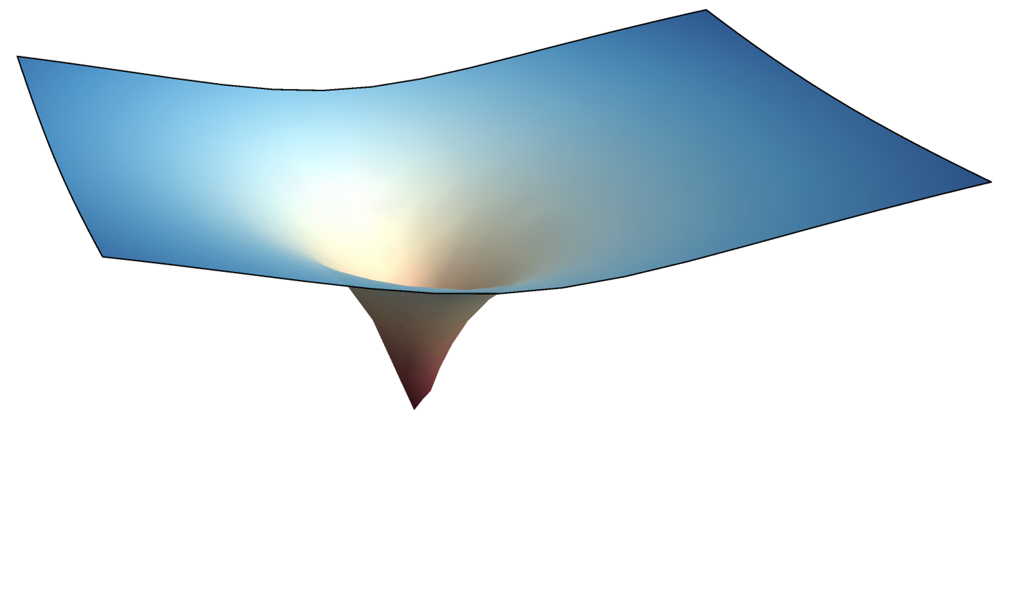
Reframing optimization as a root finding problem
Goal: find the minimum of a function
Use the fact the gradient is zero at the minimum
Can use tools developed for root finding
Newton’s method
Enables quadratic convergence
Can use quasi-Newton methods
Broyden-Fletcher-Goldfarb–Shanno (BFGS)
Lazy-Newton

Slide 7
Newton’s method for optimization
Want to find a method:
Generate an approximation of the function at a step
2. Solve the minimization problem to obtain the direction $p_{k}$
3. Newton’s method:

Slide 8
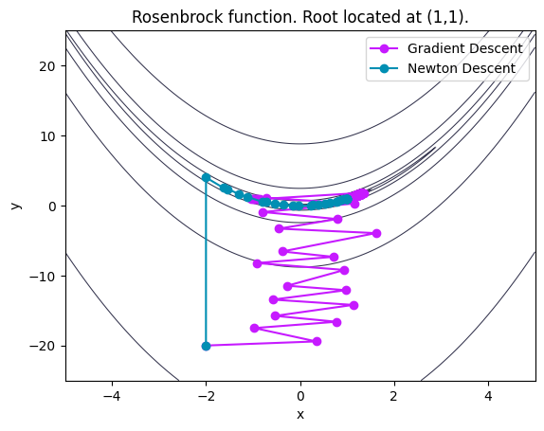
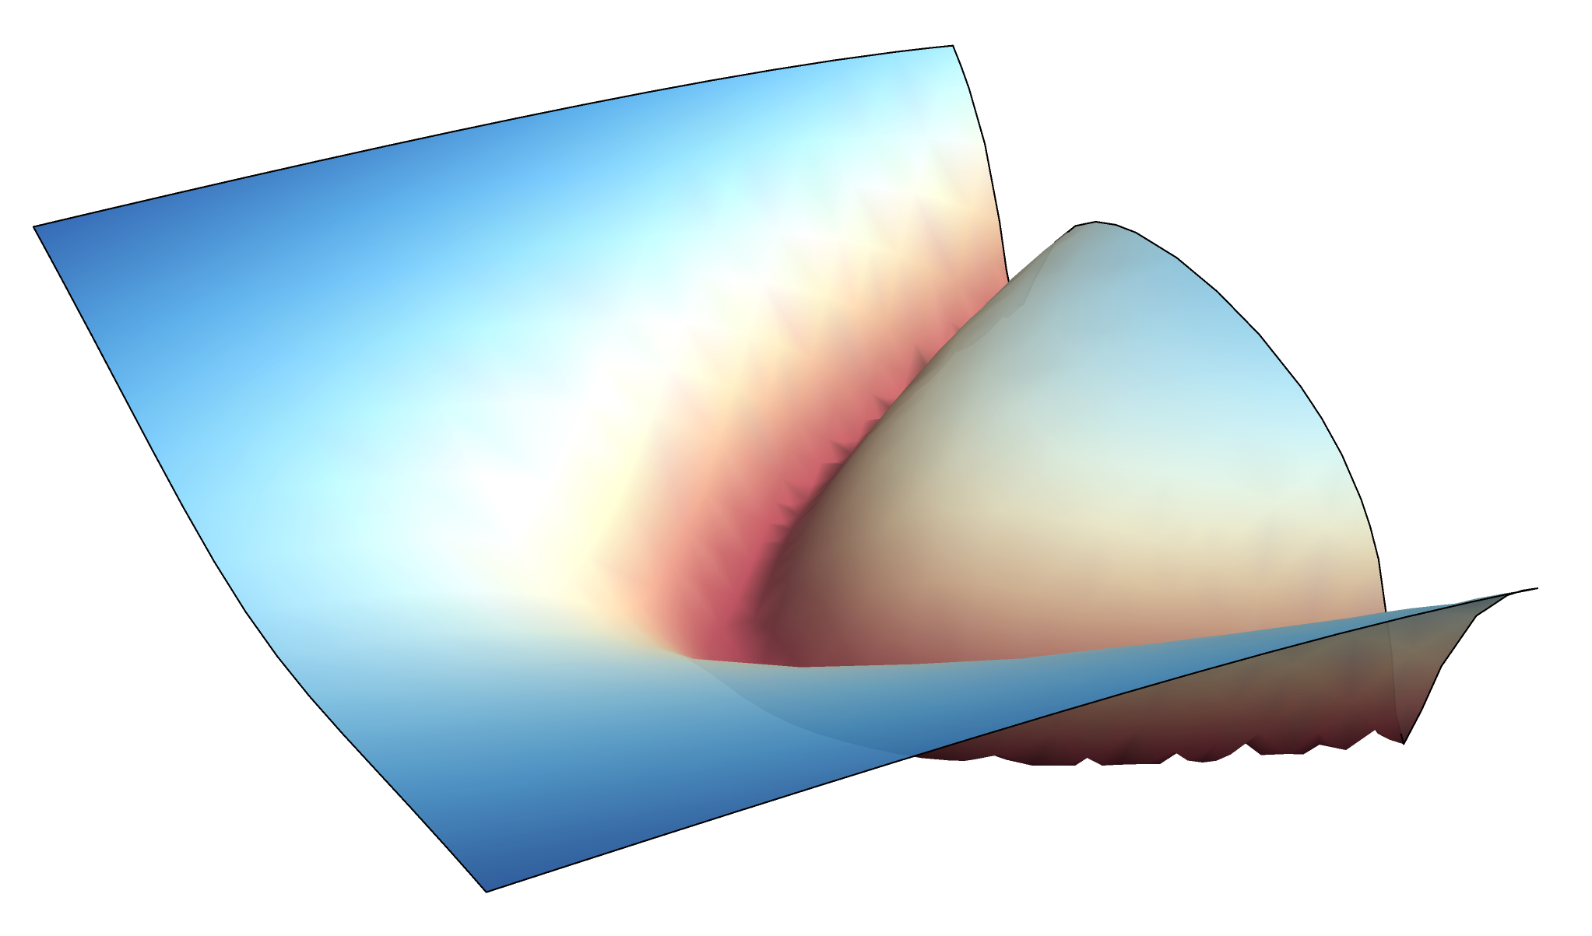
Newton’s method for optimization
Iteration:
Rosenbrock Function:
Requirements for convergence:
The Hessian matrix must be SPD
Initial guess must be in a region where the Hessian is SPD

Slide 9
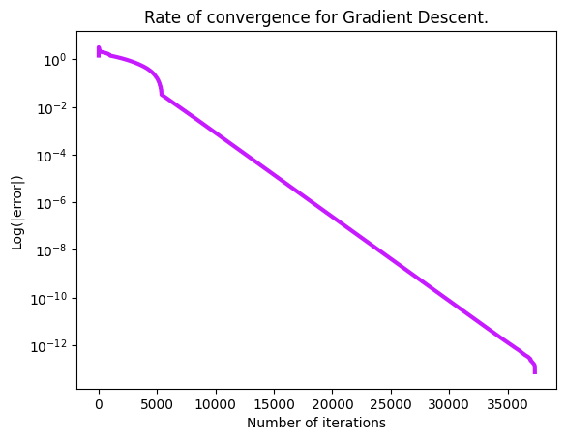
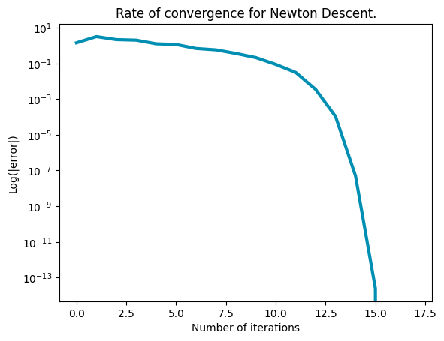
Newton’s method results in quadratic convergence
Blah blah blah blah
Gradient Descent:
Newton descent:

Slide 10
Quasi-Newton methods
Motivation:
Computing the Hessian matrix can be expensive
Solving [EQUATION] can also be expensive
Can use quasi-Newton methods to improve algorithm
Lazy-Newton/Shaminski
Broyden-Fletcher-Goldfarb–Shanno (BFGS)
Most robust popular method
DFP Algorithm
Symmetric rank-1 update (SR1)

Slide 11
BFGS as an alternative to Newton’s method
BFGS
Benefits:
Cost per iteration is less than Newton’s method
More important for higher dimensional function

Slide 12
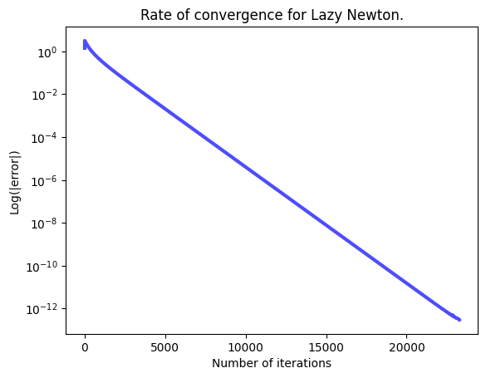
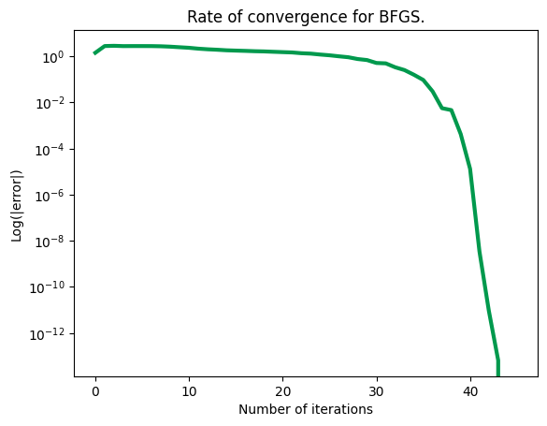
Quasi-Newton results
Blah blah blah
Lazy Newton:
BFGS:

Slide 13
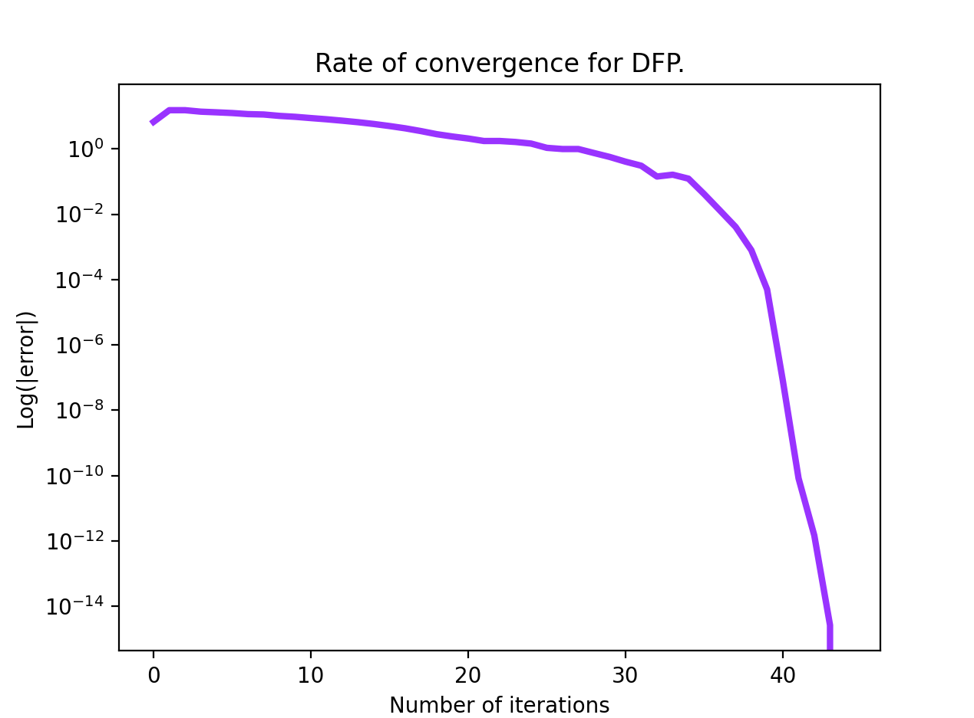
Additional quasi-Newton methods
Symmetric rank-1 update (SR1):
DFP Algorithm

Slide 14
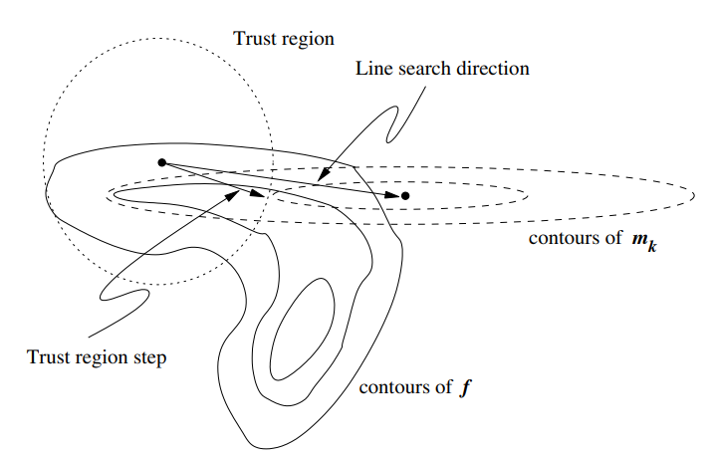
Trust region methods
Choose a maximum step length
Region we “trust” our approximation
Based on how close the approximation is to the real function
Minimize function within this region
Typically, an inexact minimization is performed
An exact approximation is overkill in most applications
Nocedal

Slide 15
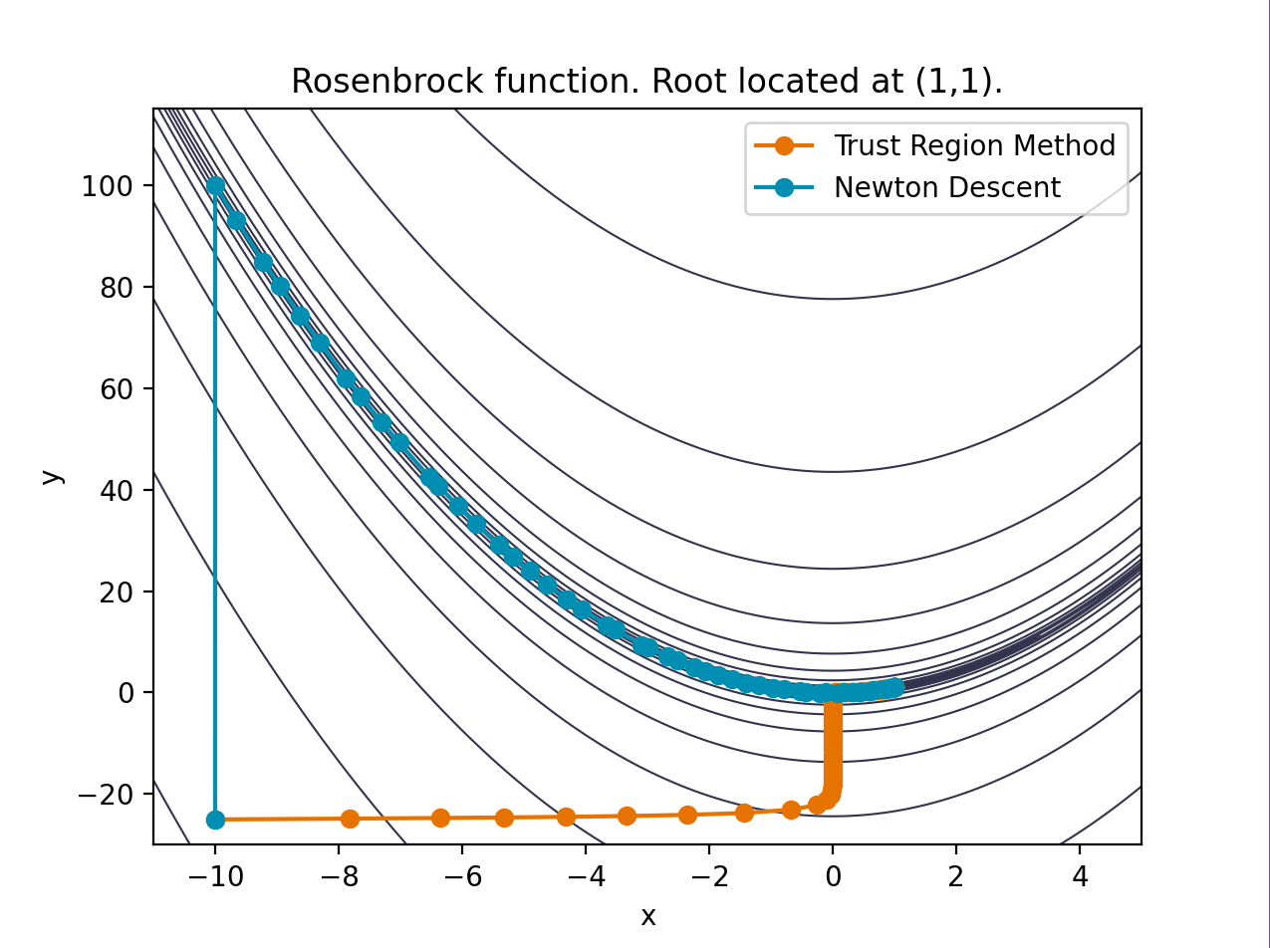
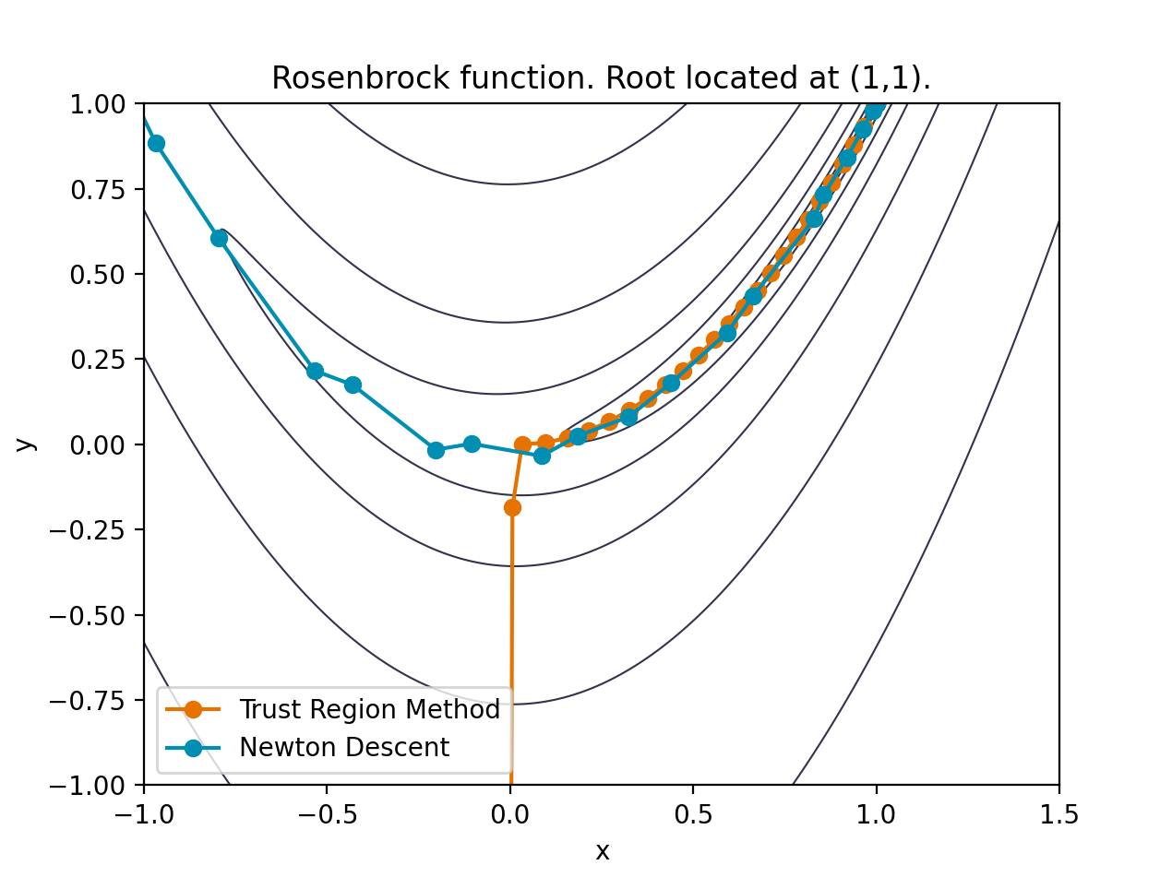
Trust region methods
Blah blah blah

Slide 16
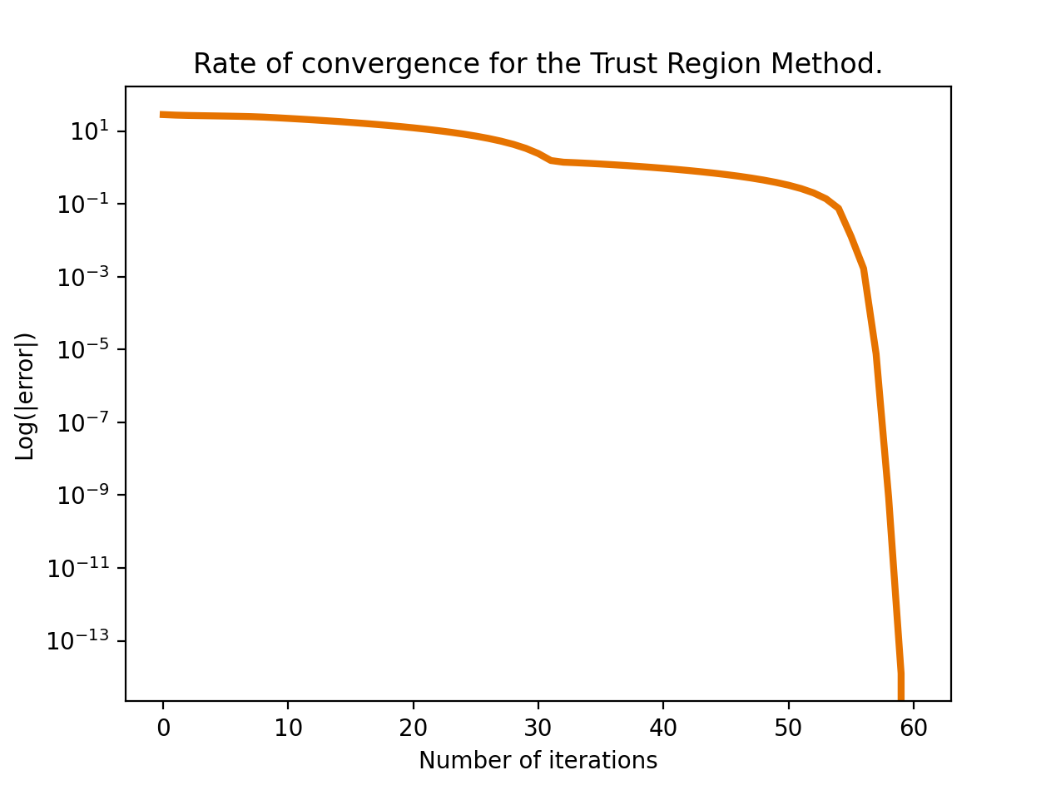
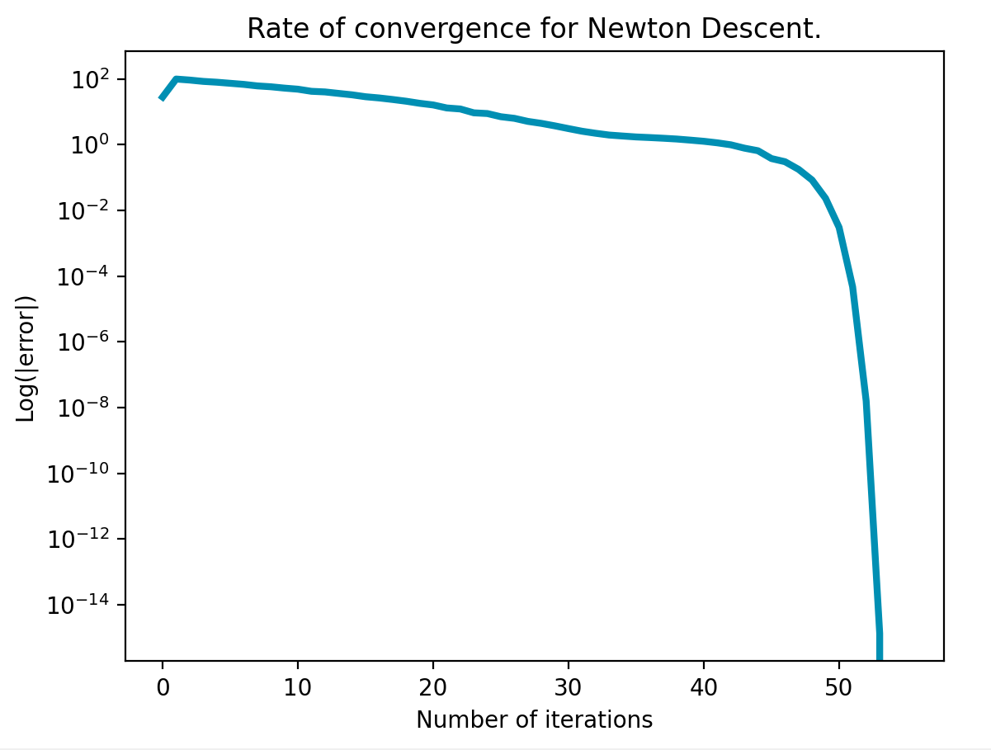
Trust region methods maintain quadratic convergence
Blah?
Trust region
Newton Descent

Slide 17
Questions?

